Slide 1
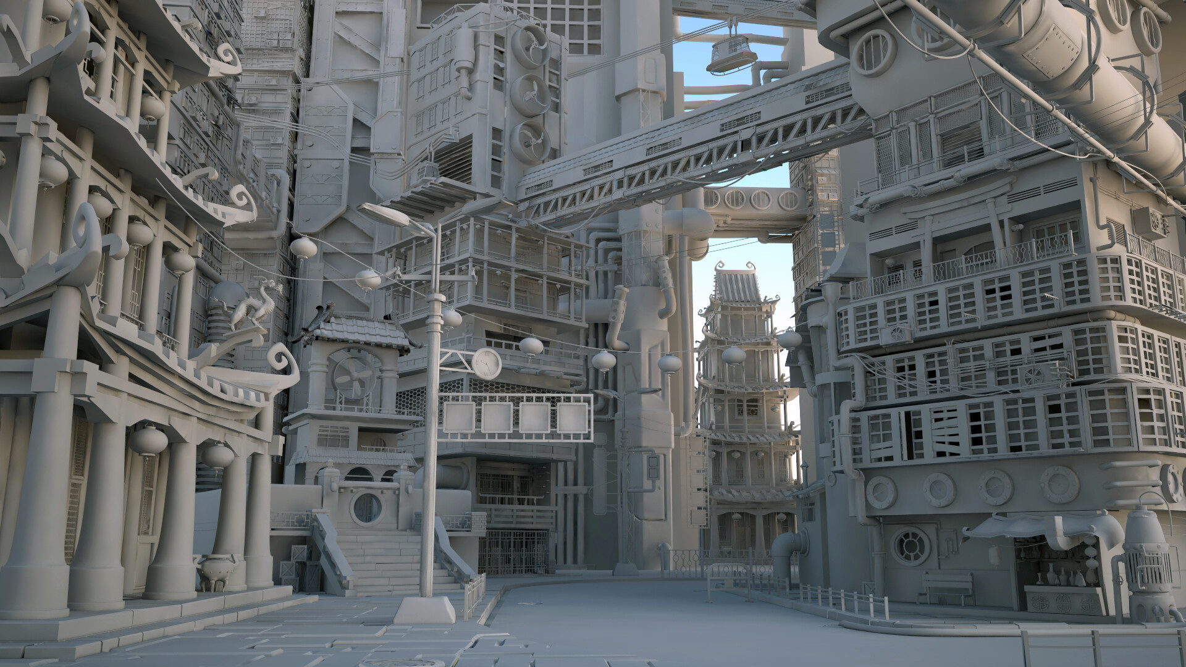
OpenGL

Slide 2

What is OpenGL?
?
Open Graphics Library (OpenGL) is a cross-language, cross-platform application programming interface (API) for rendering 2D and 3D vector graphics.
The API is typically used to interact with a graphics processing unit (GPU), to achieve hardware-accelerated rendering.
In other words, on the most fundamental level, OpenGL is a software interface that allows a programmer to communicate with graphics hardware.

Slide 3
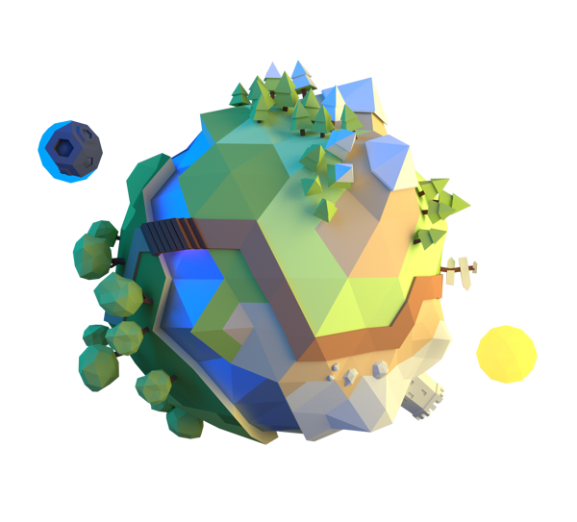
How does it work?
Open Graphics Library (OpenGL) is a cross-language, cross-platform application programming interface (API) for rendering 2D and 3D vector graphics.
The API is typically used to interact with a graphics processing unit (GPU), to achieve hardware-accelerated rendering.
In other words, on the most fundamental level, OpenGL is a software interface that allows a programmer to communicate with graphics hardware.

